Slide 1
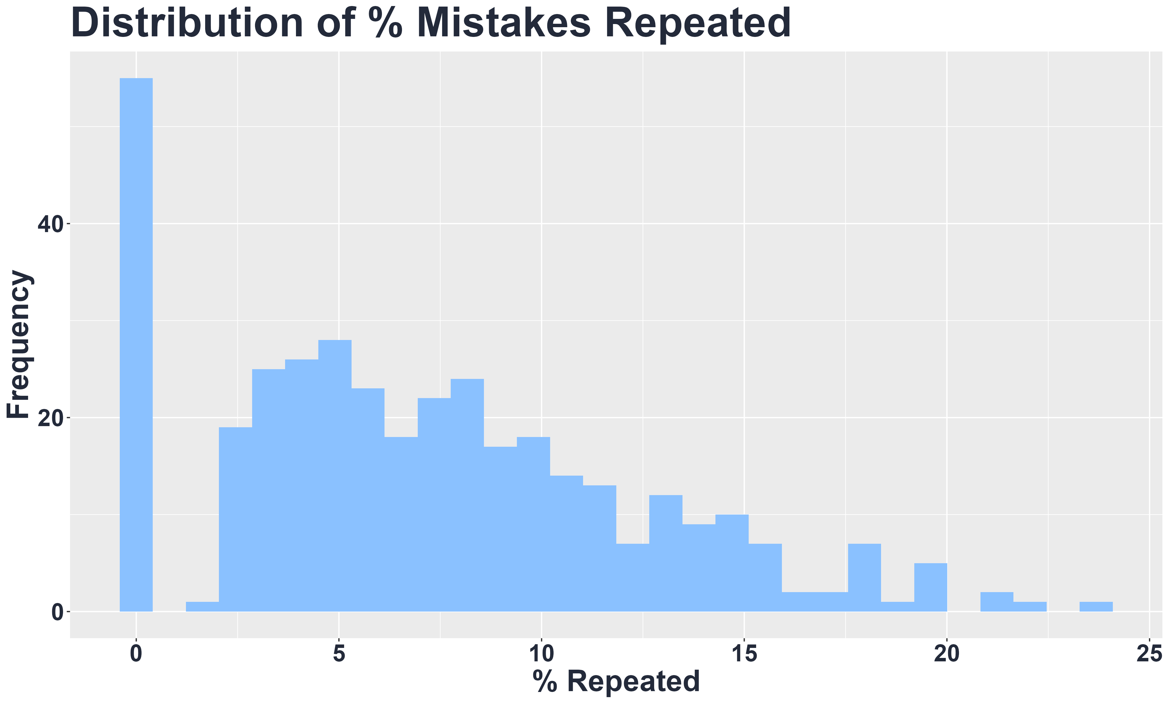
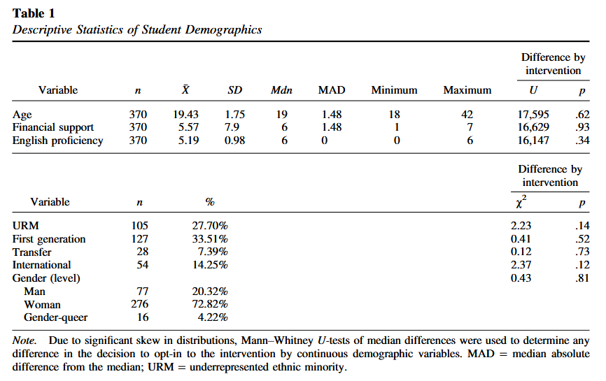
Unlocking Feedback Generalization:
The Relationship Between Metacognition, Feedback Viewing and Repeated Mistakes
Xinhui Zhang, Sydney Wood, Victoria Cross
Background
Results
Sample Demographics
Metacognition—thinking about one’s own thinking– is widely linked to self-regulated learning and higher achievement. }. {Define feedback literacy} {scaffolding to help students build feedback literacy. }
The current study
Predictions
Hypothesis 1: Overall, students repeat a smaller percentage of mistakes on questions that are repeatedly tested.
Hypothesis 2: Students who view feedback repeat a smaller percentage of mistakes on subsequent exams than those who did not view feedback.
Hypothesis 3: Controlling for feedback viewing, students in the intervention group repeat a smaller percentage of mistakes on exams after the intervention compared to before the intervention and compared to students who did not opt in to the intervention
Comment on non-normal distribution
Conclusion
Methods
Participants: 370 undergraduates in a research method course.
Intervention: Optional metacognitive exam corrections after Exam 3.
Measure:
Repeated mistakes (matched rubric items across scaffolded exams).
Analysis:
Two Multilevel mixed-effects models estimated with Restricted Maximum Likelihood and Satterthwaite's t-test method
References
Reference one
Reference two
Reference three
Reference four
Reference five

